Slide 1





Smart contract development with solidity
Intro to Ethereum and Smart contracts
Smart Contract Development with Solidity
SoftUni Team
Technical Trainers
Software University
http://softuni.bg
Logos: https://www.ethereum.org/assets

Slide 2
Questions
sli.do #SContracts

Slide 3

Table of Contents
Ethereum vs Bitcoin
Ethereum transactions - structure and types
Smart contracts interface and execution
Gas & gas Limit
Gas expenses and free operations
Overall pros/cons
Created Technologies
Write Simple Smart Contract
Solidity primitive types
Notes:
Ethereum vs Bitcoin
Ethereum transactions
Structure and types
Smart contracts
Interface, execution
Gas & gas Limit
Gas expenses and free operations
Oracles
Overall pros/cons
Examples for created technologies
Useful links (see dev.bg lecture)
Break
Solidity by example…

Slide 4
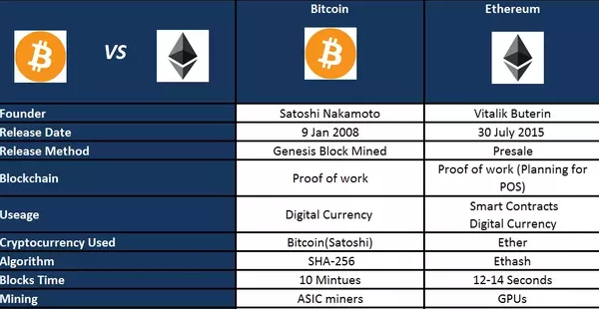
Ethereum vs Bitcoin
Usage
Source: https://www.quora.com/How-is-the-Ethereum-blockchain-different-from-the-Bitcoin-blockchain
Notes:
Ethereum is likely the most successful ICO. They started by initially selling 2000 ETH for 1 BTC (~400-500$ at the time). Oh boy what a time to invest in crypto it was.

Slide 5
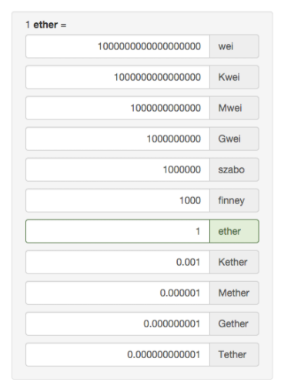
Ethereum transaction structure
A transaction (tx) contains:
Recipient (address)
Sender (address)
Value (measured in wei)
Data (if any)
An executed tx returns a tx receipt (the outcome of a tx)
Used resources
Block number/hash; tx hash
Contract related data (if any)

Slide 6

Smart contract compilation (1/2)
Bytecode
(EVM instructions)
Solc compiler
ABI definition
Ethereum Virtual Machine (EVM) is the environment where contracts are executed.
The Application Binary Interface (ABI) contains info about the contract’s interface:
Public methods, their input arguments and return values
Contract events (more on that in the next lecture)

Slide 7
Smart contract compilation (2/2)
Bytecode
(EVM instructions)
Ethereum blockchain
ABI definition
Accessing the contract
To publish the contract, the bytecode is uploaded to the blockchain
To access it (call its methods or read its memory), you need the ABI definition to know what inputs and outputs the contract operates with

Slide 8
Contract publishing
A contract has to be uploaded to the blockchain (aka published)
When published, the contract’s initializing code is run (its constructor)
Contract publishing is a transaction
With no recipient (null)
With the contract’s compiled bytecode as tx data
The tx receipt contains the contract address
Must be used to locate the contract

Slide 9

Contract execution
Is a call of a public contract function
Is a transaction
With the contract address as recipient
With ID and inputs of the called function as tx data
Icon made by Smashicons from www.flaticon.com

Slide 10

Ethereum gas measurement
Contracts aren’t free!
Gas is a measure of used computational resources
Contract execution
1 gas = 1 computational step
Example: Writing 32 bytes in the memory of a contract costs 80 000 gas
Gas price:
1 gas ~= 20 Gwei (dynamic)
Icon made by Eucalyp from www.flaticon.com

Slide 11
Gas payments
Gas is measured and paid for at each contract operation
Every transaction to a contract or contract creation
The gas price is set by the caller (you)
Too low and miners will ignore your tx!
The lower the price, the more time it will take for a miner to include the tx in a block
Useful website for the best gas price: https://ethgasstation.info/

Slide 12
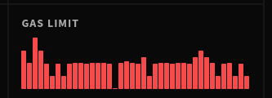
Gas limit
Maximum allowed gas usage in a block
-> sum of all gas spendings of all TXs in the block
-> it is also maximum allowed gas spendings in a single TX
The block creator can change the limit by a small factor
Do not reach the limit!
Current contract execution will be terminated
Any changes to the contract’s state will be reverted

Slide 13

Operations that cost gas
Anything that changes the blockchain state:
Writing to contract’s memory
Execution of contract logic
Uploading data to blockchain (contract publishing)

Slide 14

Free operations (no gas costs)
Anything not requiring changes, like:
Reading blockchain data (contracts, their memory, …)
A contract staying on the blockchain

Slide 15
Beware! Easy to hit the limit
Do not, if possible:
Write code with loops (no guarantee that gas won’t run out)
Recursion (function calling itself)
Create large contracts (may not even publish)
We’ll have a full lecture on optimizing later, but keep these in mind.

Slide 16

Publicity
Everything on the blockchain is public
Code (compiled) and any contract variables
Can be used to find security holes in our contracts!
All contracts, accounts, balances, transactions, ...

Slide 17

Overall: smart contract pros
The blockchain guarantee
100% uptime
No censorship or control
Completely autonomous
Unlimited life
Easily accessible (no need for servers)
Easy to develop (depends on the use case)
Easy to use (but sometimes costly)
Like a law

Slide 18

Overall: smart contract cons
Gas expenses
Can get expensive
Gas limit
Limits what can be done
Publicity
Cannot be hidden
Blockchain limitations
No internet access

Slide 20
Examples of created technologies

Slide 21

Gnosis
Prediction market
Built on top of contracts
Allows its users to speculate on the outcome of products, services or events
https://gnosis.pm/

Slide 22
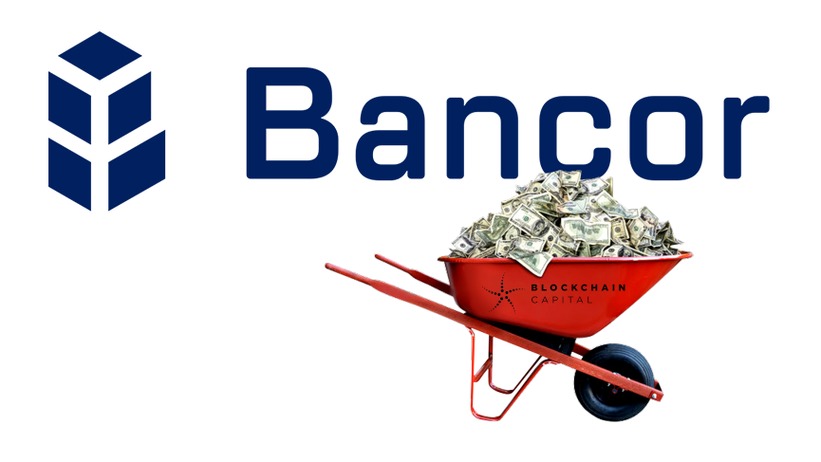
Bancor
Unify tokens, by making them “smart”
Build connections (dependencies) between tokens
Allow contract-based instant decentralized exchange between tokens
https://www.bancor.network/discover

Slide 23

Aeternity
Build side-channel communication on top of their blockchain
Raised a lot from crowdfunding
Strong bulgarian participation
https://www.aeternity.com/

Slide 24
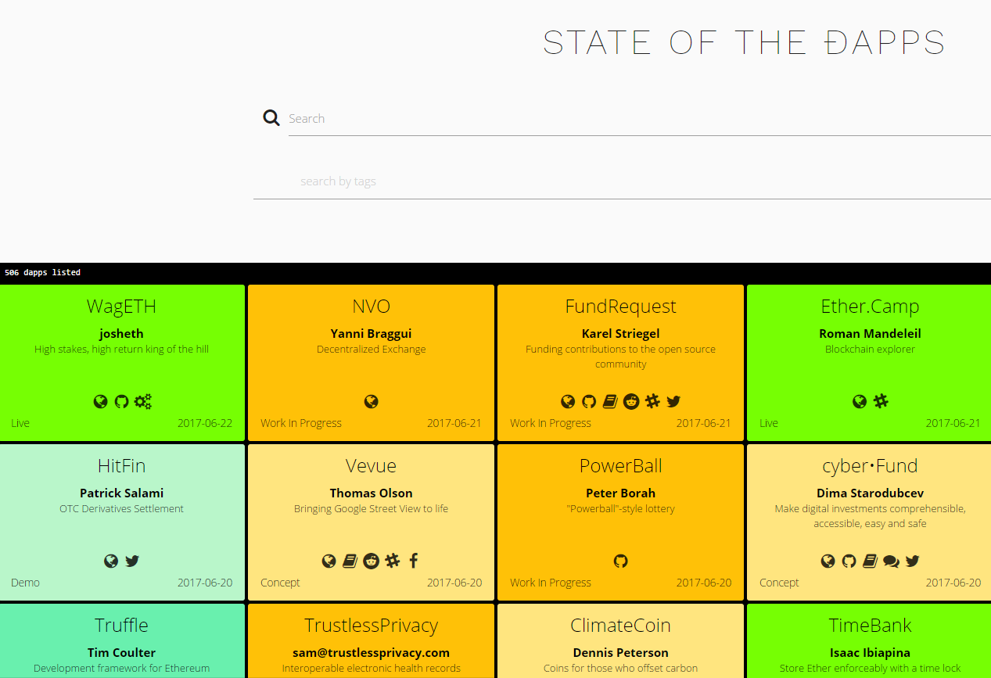
Find more Dapps at
dapps.ethercasts.com
Notes:
Website that lists recent Dapp projects

Slide 25
Let’s build a hello world contract!

Slide 26
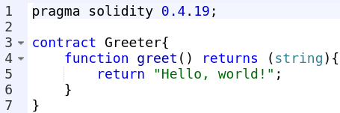
Let’s explain a hello world contract
The whole contract:
Let’s explain it, line by line.

Slide 27
The “pragma” line
Defines the version of the solidity language this was developed in
Important! A contract should not be compiled with newer solidity versions without proper testing!
New versions may introduce compiler bugs!

Slide 28
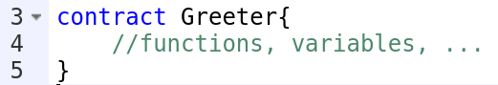
The contract definition
Defines a contract with a name.
Similar to defining a class in OOP languages
The contract contains data and the logic to operate

Slide 29
The function definition
Defines a publicly accessible function greet with no input arguments that returns one value of type string.
The syntax of input arguments is the same as in C#
The return values can be multiple and their types are specified in parentheses

Slide 30
The return statement
Returns the expected string

Slide 31
Let’s write the contract at http://remix.ethereum.org
Notes:
Важно е да отвориш remix-a с hello world кода (или го напиши тогава, или го имай готов).
Трябва да им обясниш, че remix-a може да симулира локален тестови блокчейн - блокчейн, в който само ти си член и имаш безкрайни ether-и. Съответно можеш да публикуваш и изпълняваш договори колкото си искаш.
Трябва да им покажеш как да си публикуват договора и после как да извикват някой от методите му и съответно да гледат output-a от транзакцията
Изчакай ги повечето да свършат с упражнението преди да продължиш

Slide 33
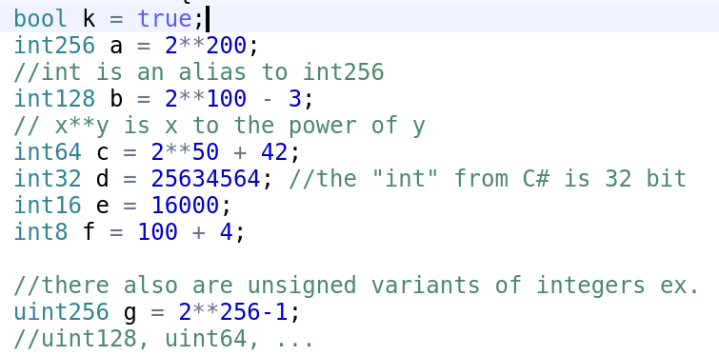
Solidity primitives
integers
booleans
Notes:
The solidity primitives are integers (no floating point numbers!). They can be signed and unsigned (explain the difference briefly). The types depend on the size of the int (ex. Int32 is a 32 bit int).
The default int (“int”) is int256. Solidity uses large ints because work working with ETH transfers, a measurement in wei is always used (the smallest unit of ETH), which makes really large numbers.

Slide 34
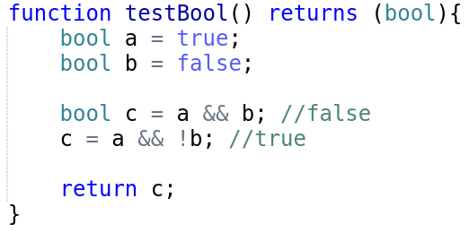
Boolean operations
! (logical negation)
&& (logical conjunction, “and”)
|| (logical disjunction, “or”)
== (equality)
!= (inequality)

Slide 35
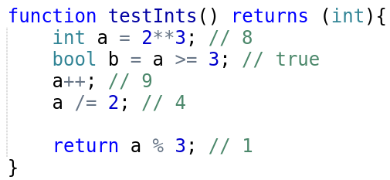
Integer operations
Comparisons: <=, <, ==, !=, >=, > (evaluate to bool)
Arithmetic operators: +, -, -- (unary -), ++ (unary +), *, /, % (remainder), ** (exponentiation, works only with uint numbers)
Assignments: =, +=, -=, /=, *=

Slide 36
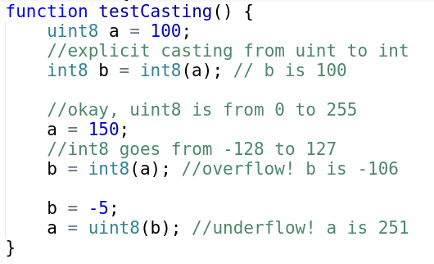
Explicit casting
Any primitive type can be explicitly cast to another to be used temporarily in an expression
May cause overflow!
When a type’s max or min values are surpassed

Slide 37
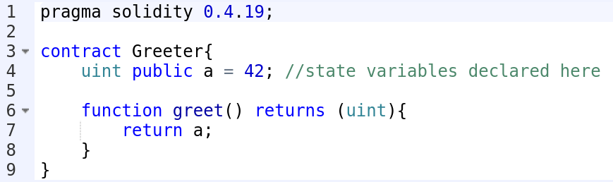
State variables
Contract data that is kept in between calls

Slide 38
Let’s write a decentralized counter

Slide 39
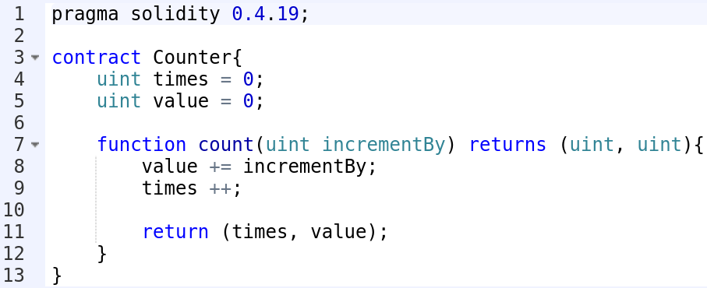

Slide 40
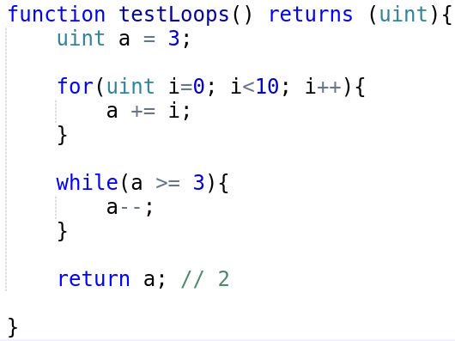
Loops
The loops and if and statement in solidity are the same as in C++, C#, Java, …
Avoid loops with unknown number of iterations at all costs!

Slide 41
Exercise
Create a contract with mathematical functions that:
Add/subtract/multiply/divide two numbers
Raise the first number to the power of the second
Return the remainder of the first number in division by the second one
Each function returns the result
The ** operator works only with uint types. Can you make your power func raise an int number on a uint power?
Test and play around with the contract.
Can you think of ways to break it so it returns incorrect results?

Slide 42
Homework
Take your math contract and modify it so:
The math functions take only one argument, number 2.
Number 1 is kept as a state variable with initial value 0
Each math function executes its operation with number 1 and 2 and stores the result in number 1
Create a function to get the state (number 1)
Create a function that resets the state to zero
Test it and play with it.
Perhaps add more complex logic?

Slide 43
Summary
A general view of Ethereum’s smart contract framework:
Transaction structure, gas expenses.
Contract compilation
Contract publishing & execution
Examples for created technologies
Solidity primitive types
Integers, booleans and operations
State variables
Functions
Loops

Slide 44







https://softuni.bg/courses/

